Slide 1

AI in Global Health Education and Curriculum Design
CUGH AI Working Group
April 9, 2026

Slide 2
Agenda
Session Overview
Intro to AI & Global Health Education
AI & the Global Health Workforce
AI in Clinical Education
Closing & Evaluation

Slide 3
CUGH AI Working Group Mission
The AI Working Group at the Consortium of Universities for Global Health seeks to improve the wellbeing of people and the planet by advancing innovative, ethical, and equitable integration of artificial intelligence into global health. Through education, we create accessible resources to deepen understanding of AI’s potential and challenges. Through research, we drive innovative AI solutions to address global health disparities. Through service, we foster cross-sector partnerships to implement cutting-edge AI applications. Through advocacy, we promote policies that ensure equitable access to transformative AI technologies, aligning with CUGH’s mission to enhance health equity and sustainability worldwide.
Key Activities:
Webinars with leaders in AI
Two-pagers introducing AI topics
AI curriculum needs
Guidance on AI use in global health education
Commentaries on AI integration in global health
Conference sessions

Slide 4
Session Goals
1.
2.
To share and document perspectives and priorities among the CUGH community related to AI
To identify opportunities for the AI WG to support cross-cutting needs within CUGH
3.
4.
To refine the AI Working Group Scope of Work to align with CUGH member priorities
To recruit working group participants with diverse perspectives who can lead CUGH AI WG activities

Slide 5

AI and Global Health Education
Katherine Robsky, PhD MPH
Assistant Professor
Georgetown University
katherine.robsky@georgetown.edu

Slide 6
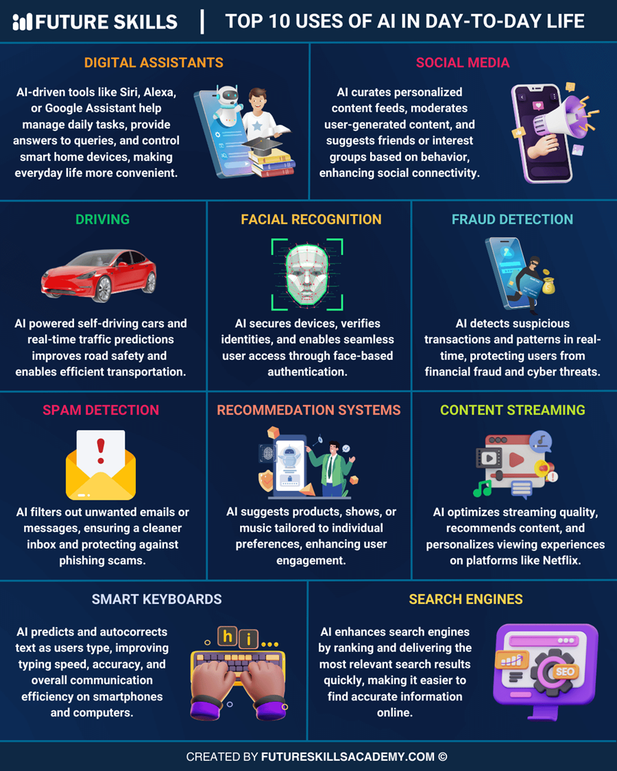
What is AI?
Artificial Intelligence: systems that perform tasks that normally require human intelligence (ability to learn, reason, make decisions, and adapt)
AI is a toolbox, not a single technology

Slide 7




What is AI?
Machine Learning
Deep Learning
Generative AI
Algorithms and models for prediction
Machine learning using artificial networks
Creation of images, text, or videos

Slide 8
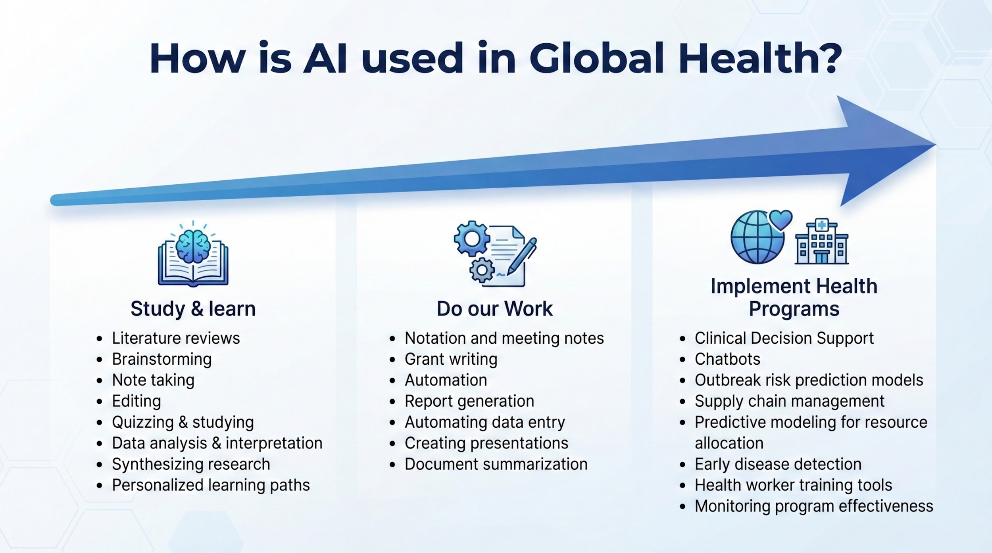
How is AI used in Global Health?

Slide 9
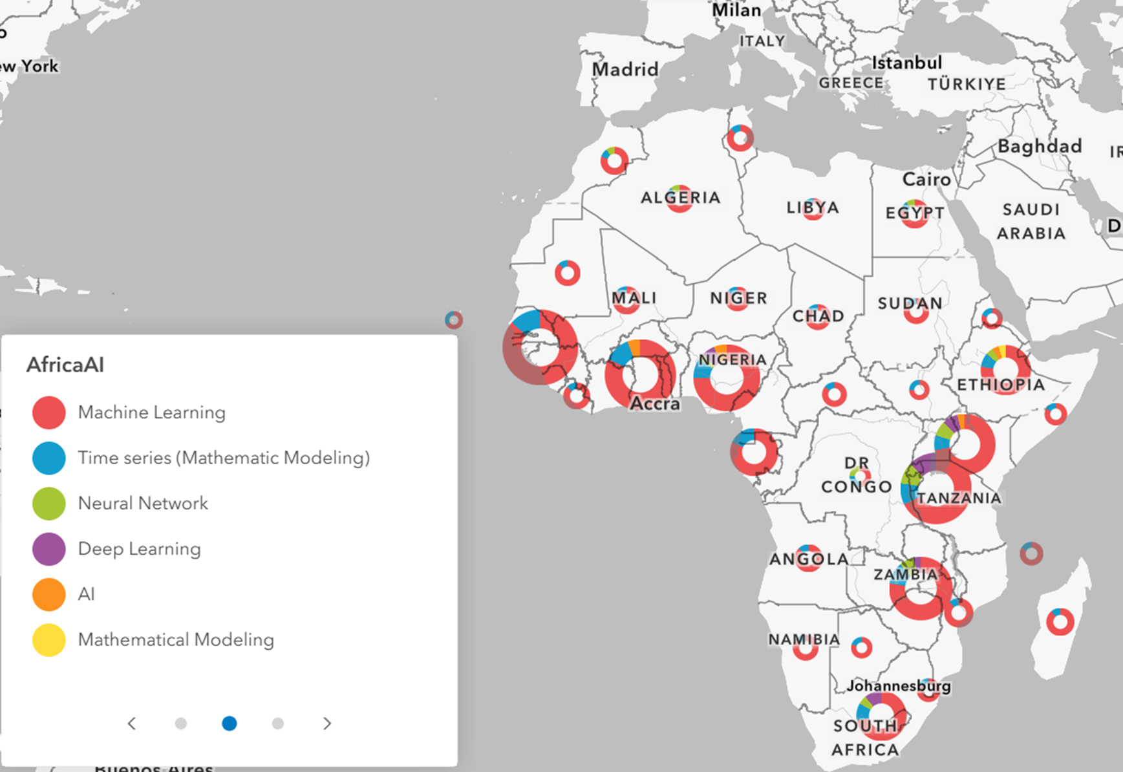
Case Study: Predictive AI in Global Health
Scoping review of predictive AI in Africa
80 predictive AI studies
54 African countries
Infectious disease focus (61%)
Machine learning most common (67%)

Slide 10
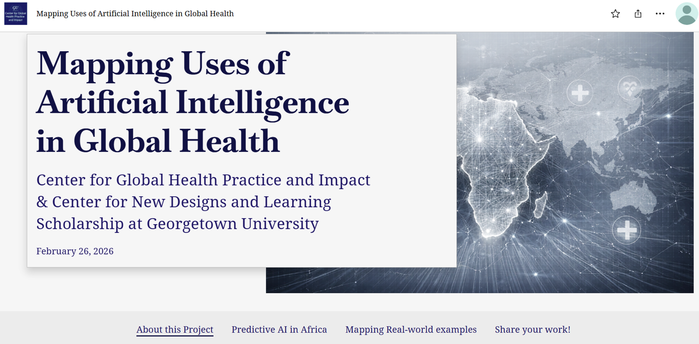

Case Study: Predictive AI in Global Health

Slide 11
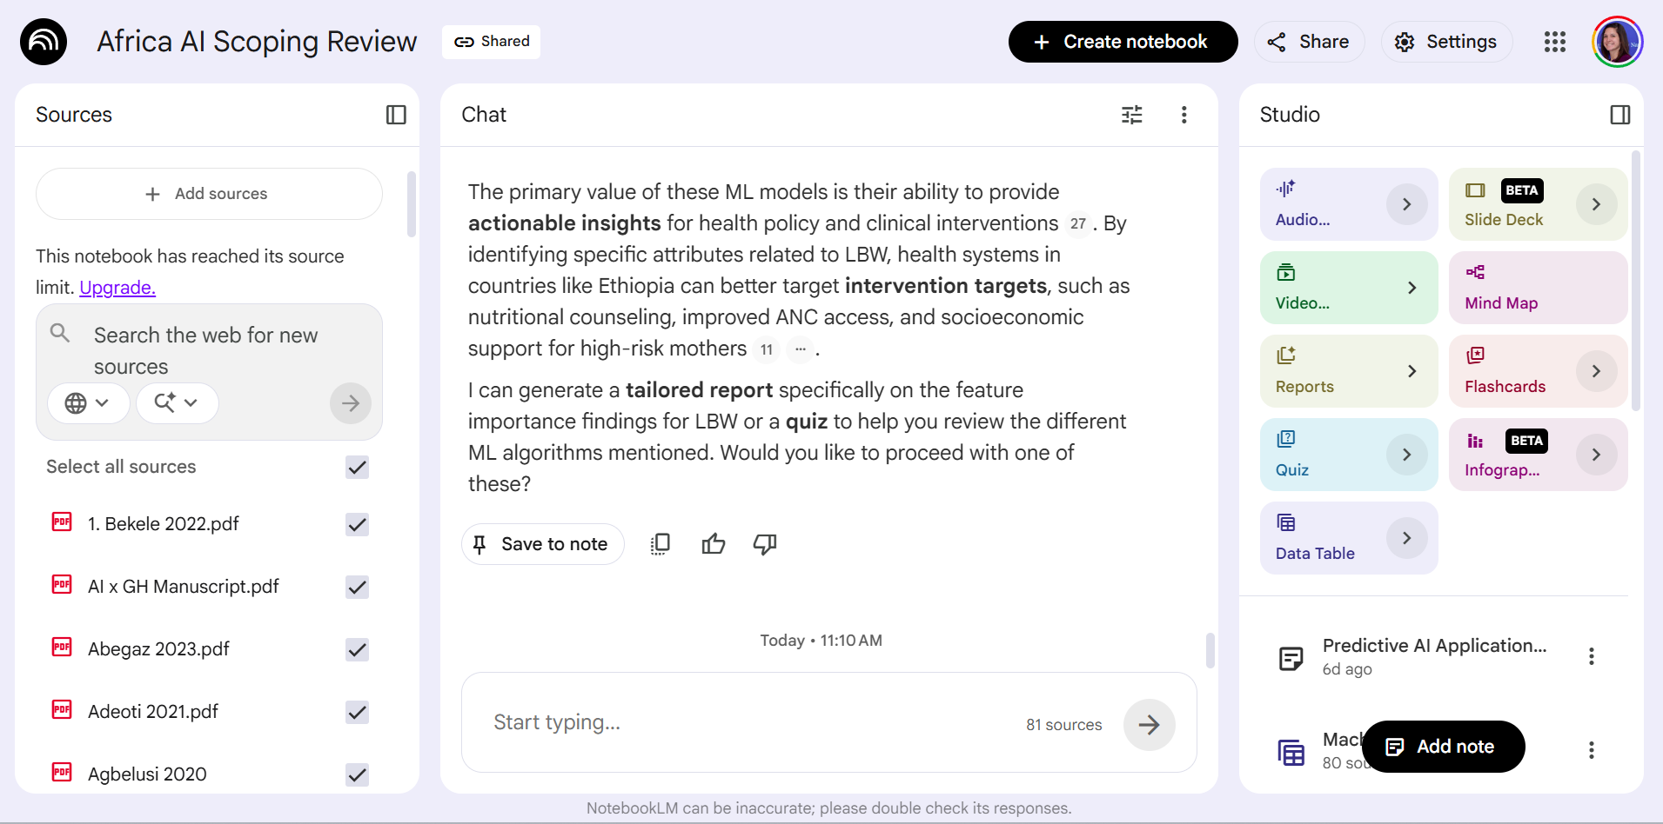
Case Study: Predictive AI in Global Health

Slide 12
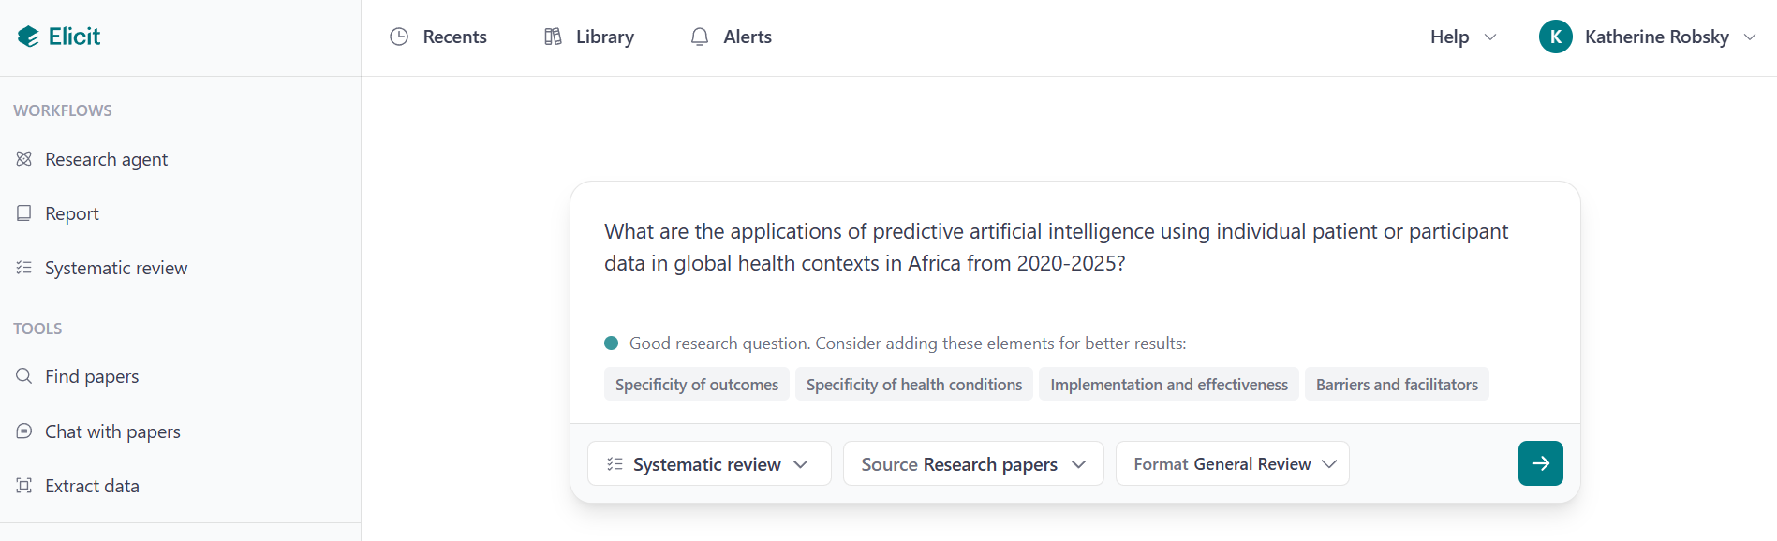
Case Study: Predictive AI in Global Health

Slide 13
Conclusions
1
2
3
AI is a toolbox with many potential uses in global health, including how we study & learn, do our work, and implement health programs
Tell potential investors how you plan to leverage momentum after your launch.
AI is already embedded in global health
Tell potential investors how you plan to leverage momentum after your launch.
Global health as a field needs to adapt - quickly
Tell potential investors how you plan to leverage momentum after your launch.
AI neither good nor bad - it depends on its use

Slide 14

What are your thoughts, concerns, and questions regarding the AI in the context of global health education?
Consider:
How is AI currently reshaping how you learn, teach, or share knowledge within the global health community?
What specific skills or competencies must students and practitioners develop to use AI effectively and ethically in their work?
What resources or initiatives should CUGH prioritize to support your understanding and use of AI?
Activity: Networking & sharing (10 min)
Report back (10 min)
slido.com/3848943

